Slide 1

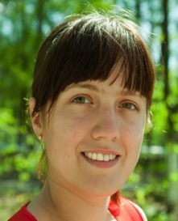

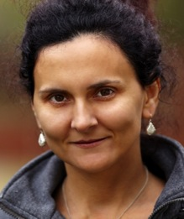
"Womenomics" & Gender-Inclusive Software: What Software Engineers Need to Know
Margaret Burnett, Oregon State University
2016 ACM Symp. Foundations on Software Engineering
Video of a similar talk (start 3:45 minutes in)

Slide 2
1 week after the election: SE and Society
SE has a lot to think about.
Automation-displaced, angry blue-collar workers.
Social media “of interest to you” bubble.
“Impact of what SE causes isn’t my job”
Social debt
Q: How to pay it? A: Tech is power.
There are some things only SE can fix.
Here’s one of them.

Slide 3

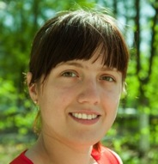
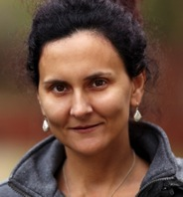
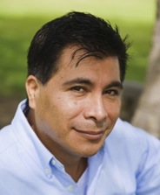
Unconscious Bias in Software
Q: Does software …
support a variety of smart users?
A: No.
Unconscious bias, supporting (mainly) 1 kind of user.
Raise awareness of unconscious bias in software:
Concretely via GenderMag (beta): to find gender inclusiveness issues in software.

Slide 4
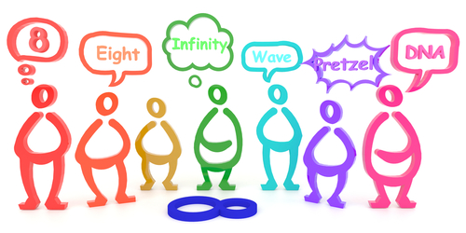

Reason #1 to care: Society’s Health
Premises:
Bad: bias in software
Good: diversity of thought
Solutions:
Fix the people: force us all to think as software “likes”.
Fix the software: support diverse ways of problem-solving.

Slide 5
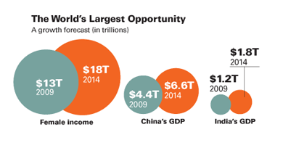
Reason #2 to care: The economics
Women drive 70-80% of consumer purchasing [Forbes]
Women: the largest emerging market [Harvard Busn Rev]
More than 2x China+India’s GDP combined
Women have multiplier effects:
Primary caregivers (most societies), so…
Also buy on behalf of others who live with them

Slide 6
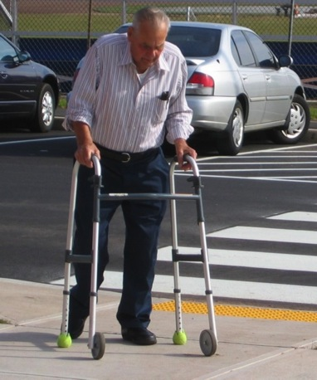
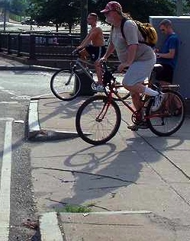
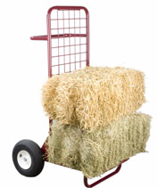
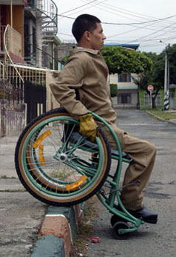
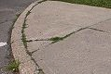
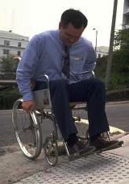

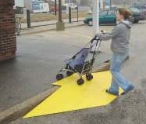
Reasons #3-4 to care about gender-inclusive software?
Reason 3. Ignorance ➔ unwitting barriers.
Reason 4. Studying a population segment to help everyone.
Curb cuts.

Slide 7
Reason #5. The target customers: eg, A Critical Email
From:
Software product manager “John” at “Company X”
Software for:
medical folks to “program” …
medical devices for their patients’ needs.
Problem:
85% of customer base: females.
Females don’t like the software.
Development team (all males) doesn’t know why or what to change.

Slide 8
ok, I care. How??
“We want your $. Here’s a surface gesture to show that we’re not thinking about you”
Shrink it and Pink it is not a strategy
Dell’s pink laptops (2009)
BIC for her
If you’re a man:
Research/listen to women as a foreign market.
People grow up within the culture of their gender.
Within-gender: more different than alike.
So… needs to be about inclusiveness
Not about “typical” females or males
How: GenderMag
If you’re a woman,
If you’re a non-traditional gender,

Slide 9


The GenderMag Method: A Software Process
Abby
Tim
Gender Inclusiveness Magnifier
Process: Evaluate tools’ inclusiveness
Scope: Problem-solving
GenderMag has:
Personas: 5 gender inclusiveness facets
Gender-specialized CW:
Embeds facets & personas into a process
Pat (Patrick & Patricia)

Slide 10
GenderMag’s 5 facets + Abby/Tim/Pats
GenderMag Personas:
”representatives" of a range of users, but only…
…from the perspective of 5 facets:
Motivations
Information processing style
Computer self-efficacy
Risk averseness
Tech learning style (tinkering)
Tim
Abby
Pat (Patrick & Patricia)

Slide 11

abby

Slide 12
abby-Self-Efficacy
Facet #1
… comfortable with technology she uses regularly, but…
Computer Self-Efficacy: Abby has low confidence about doing unfamiliar computing tasks … and she often blames herself for problems …
…

Slide 13


Computer self-efficacy [Bandura]
A form of self-confidence:
W.r.t. a specific task.
A general theory.
Predictive of:
Willingness to try, perseverance, …
Literature:
Females lower computer self-efficacy than their male peers [Beckwith, Burnett, Hartzell …]

Slide 14
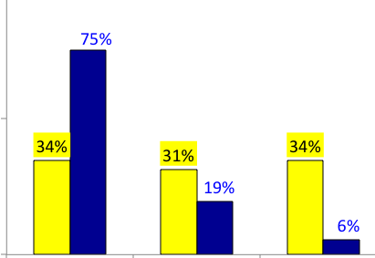

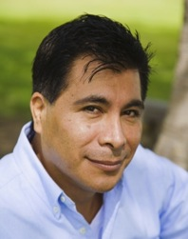


Computer self-efficacy data & the personas
High
Medium
Low

Slide 15
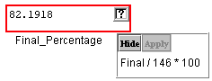
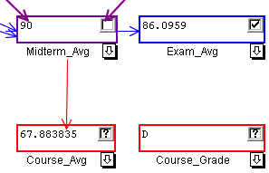
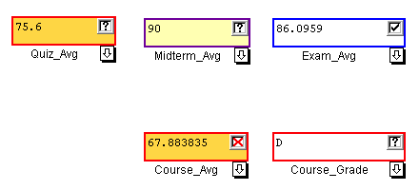
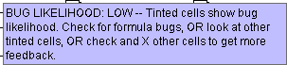
Features + self-efficacy [Beckwith]
Type familiar: formula edits.
Type taught: √, ->.
Type untaught: X.

Slide 16

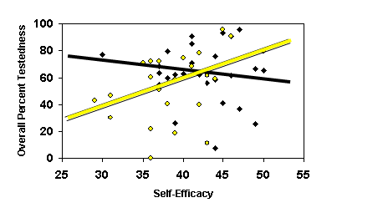



Confidence and features [Beckwith]
Self-efficacy as a predictor of effective use:
F lower computer self-efficacy than M.
F: self-efficacy mattered to willingness to use new features. (Not so for M).

Slide 17
Interest in new features
Try the features?
Time to first usage:
Use the features?
Genuine engagement:
Usage counts | Familiar | Taught
Males | 24 | 123
Females | 30 | 88
Time- to-first
People counts | Untaught Not Used by... | Untaught Used by...
Males | 5 | 22
Females | 13 | 11
Fam.
T.
UnT.

Slide 18
Their goal: Find and fix bugs
Bug counts | Seeded Bugs Fixed | New Bugs Introduced
Males | 6 | .1
Females | 6 | .6
No difference
Difference

Slide 19
abby: risk
Facet #2
…
Attitude toward Risk: Abby rarely has spare time. So she is risk averse about using unfamiliar technologies that might need her to spend extra time on them….
…

Slide 20
Risk

Slide 21

F: Risk Aversion + Low SE -> A self-fulfilling prophecy
F’s statistically more risk-averse than M [Weber].
F’s: statistically lower self-efficacy
F’s self-efficacy -> feature usage (but not M).
F less likely to accept features
Opinion: too long to learn (RISK)
But: no difference in learning!
Using features safest!
Formula edits = only way to add new bugs
so laws of probability -> add bugs.

Slide 22
Abby: tinkering/ways of learning tech
Facet #3
…
….
Learning: by Process vs. by Tinkering: Abby leans toward process-oriented learning, e.g. ... step-by-step processes, … how-to videos, etc. She doesn't particularly like learning by tinkering with software.

Slide 23




Tech Learning: by Tinkering? [Beckwith, Burnett]
Females’ tinkering to learn:
Tinkered less.
Prefer other ways of learning tech.
Tinkering “pausefully”
But when F did tinker, was “pauseful”.
Education literature: pauses improve critical thinking
Our results: pauses predictive of …
Understanding
Effective use of these features
Males:
Tinkered more.
Sometimes pauseful too…
but sometimes went crazy.
When went crazy, it hurt.
Females
Males

Slide 24
abby: info processing
Facet #4
….
Information Processing Style: … comprehensive… gathers information comprehensively to try to form a complete understanding of the problem before trying to solve it.

Slide 25


Information Processing
Comprehensive vs. Selective [Meyers-Levy]
“Everything first” vs. “Depth first”
In batches vs. Highly incremental
Here’s what it looked like in a sensemaking study…

Slide 26
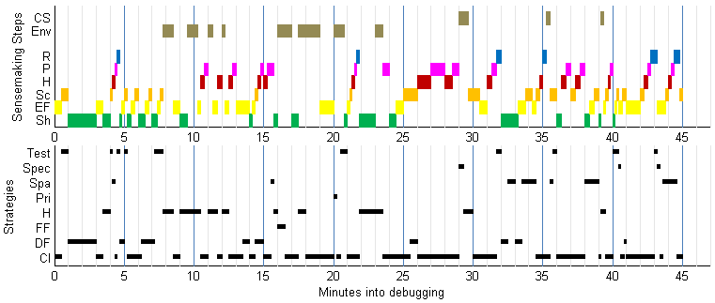
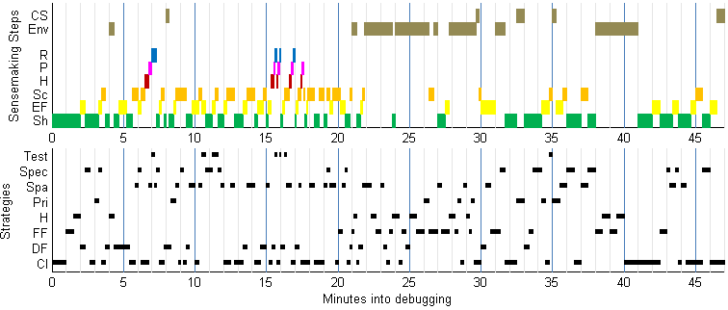
Information Processing [Grigoreanu]
Example (M top, F bottom):

Slide 27
abby: motivations
Facet #5
Motivations:
… to accomplish her tasks. She learns new technologies if & when she needs to, but prefers … methods she is already familiar and comfortable with, to keep her focus on the tasks …

Slide 28

Looked like this for one of our Fs…
“… So 0 to 100 [is the guard I’m entering], ok.
Ok, hmm… So, it doesn’t like the -5 [...]. They can get a 0, which gets rid of the angry red circle.”

Slide 29

And like this for one of our Ms
“The first thing I’m going to do is go through and check the guards for everything, just to make sure none of the entered values are above or below any of the ranges specified. So, homework 1—actually, I’m going to put guards on everything because I feel like it. I don’t even know if this is really necessary, but it’s fun.”
(continuing from above):
“…ok, so it doesn’t like my guard apparently. Ok, ah ha! The reason I couldn’t get the guard for the sum to be correct is because the sum formula is wrong.”

Slide 30
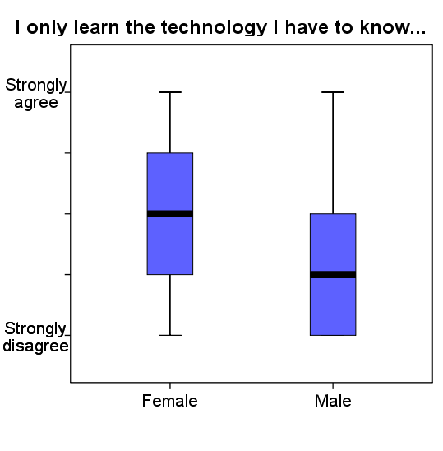
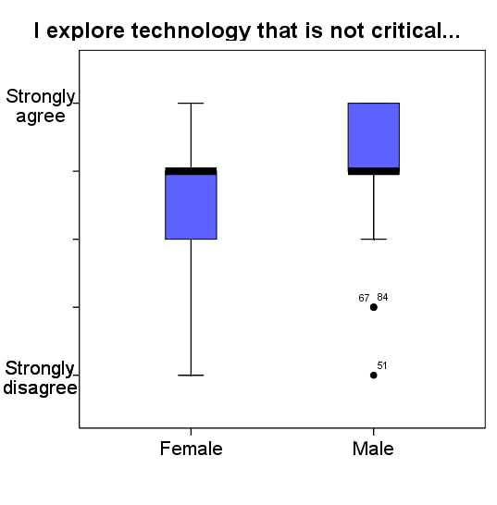
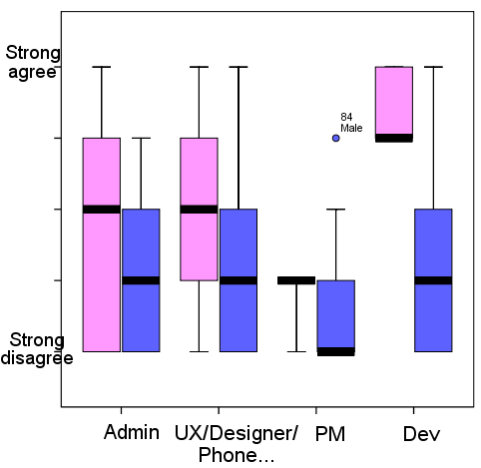
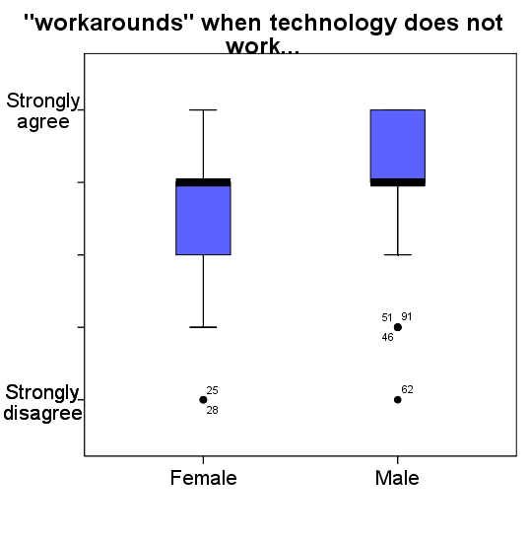
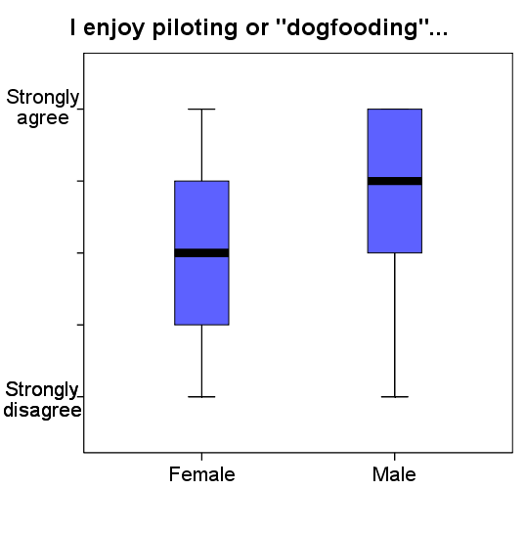
Across Populations [Burnett]
Stay with familiar features:
Fiddle with new ones:
pink

Slide 31
So…
Now you know this and I know this.
GenderMag is to let “John” use this.
So his med techs’ software can be more gender-inclusive
and his company can survive.

Slide 32
GenderMag Cognitive Walkthrough
Standard CW: evaluates usability & learnability for a first-time user.
Set-Up Phase:
Decide on scenario and a path thru it.
Analysis Phase: For each “ideal” action:
Use prototype to step through the "ideal" path, answering specific questions along the way.
GenderMag CW: integrated reminders to the relevant persona facets, like this ➔

Slide 33
The Process: GenderMag CW
Each subgoal: Will have formed this sub-goal…?
Yes/no. Why?
Each action:
1. Will know what to do?
Yes/no. Why?
2. If action … will see progress to subgoal?
Yes/no. Why?
Abby
/maybe.
Consider Abby’s Motivations…
Abby
/maybe.
Consider Abby’s , … Tinkering
Abby
/maybe.
Consider Abby’s Self-Efficacy & …
…disinclined to push and poke…

Slide 34
Does it work? Empirical Overview
From:
Formative case study at Company X [IwC’16]
Formative Workshop Event at VLHCC’13 [IwC’16]
Lab Study with UX practitioners in London [IwC’16]
Field study (4 real-world software teams) [CHI’16]
Working with several companies with Microsoft in the lead
Results:
People: Usable by UX’ers, developers, etc. [CHI’16, VLHCC’16]
Products: Makes them better! [IwC’16 + unpublished]

Slide 35
GenderMag in the Real World: Field Study
Agency G: GB, GS | Company E | Company W
M+F devs & mgrs | M devs | M+F devs & UX
Abby | Abby | Abby and Tim
Travel | Machine learning | Mobile app
10 yrs old | Pre-release | Post-release & re-design
For operators | For developers | For smart phone users

Slide 36
Results: Inclusiveness Issues
Inclusiveness issues: due to facet values.
— Enter <tag>
— On the map, click <place>
How would <Abby> know…? She prefers ... step-by-step.
She doesn’t like to tinker, ... she’s risk-<averse>.

Slide 37
Agency G: How’d it go?
GB: at first, ho hum...
Then they relayed to the boss…
GS: Very excited.
Good use of facets.
Facets vs. Gender:
They get it!
I’ve seen this!
…wasn’t necessarily about the gender… it’s <facet values>.

Slide 38

E: Utility & Follow-Through
…about gender, or is it ... people differences?
…makes it easy to detect those things.
Diversity is key.
Revealed things they hadn’t ever noticed.
2 weeks later…
Had fixed 3 of the issues they found.

Slide 39


Company W’s Follow-Up
After a few weeks:
Didn’t “own” the features, hard to convince others.
But Team W believed,
& persisted…
… and got the important issues fixed!
After 5 months:
Spin-off groups and related labs using.
After 10 months:
Exploring wide, long-term usage.
“Abby” lives on in the <x> lab.

Slide 40




So, the bottom line is:
Gender inclusive software rests …
Not on “gender bucketing”,
Rather on supporting diverse ways of thinking & problem-solving.
One gender at a time
Women in tech do not generally need extra help, but the <software> in which they work does need help.
-facet-

Slide 41
Call to Action: Let’s Fix This!
There are problems that only SE can fix.
This is one of them.
Who does this affect?
Raise your hands if…
What you can do:
Download it. Try it. Evangelize it. Talk to me.
Let’s change things!

Slide 42




Follow-ups & Resources
@GenderMag, #GenderMag
gendermag.method
Resources: gendermag.org
Flyer, papers, personas, foundations, kit!
Video of a talk on this topic (start 3:45 minutes in)
Help make it happen @ your university/company!
web.engr.oregonstate.edu/~burnett/
Margaret.Burnett@oregonstate.edu
GenderMag

